Slide 1
Victoria DeBoon
Director, Nationals SAP Concur
Canada

Slide 2
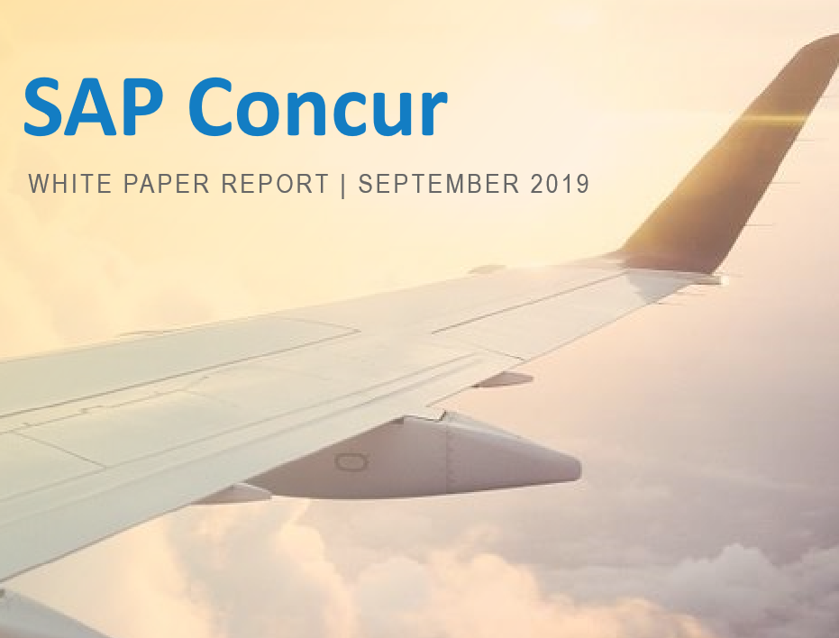
Business Traveler Report SAP Concur 2019
Key findings
Battling Stress
Business Travelers want more support
Safety & Security
Female Safety
Technology: a Solution at hand
Stress levels have increased when planning trips
Policy confusion
Business Travelers want access to mainstream tools
Expense process
Notes:
53% of Canadian business travellers say their companies have structured travel policies. 47% have policies that are unstructured or only somewhat structured, with rules that are not comprehensive.
31% of Canadian business travellers at companies with formal travel policies prioritize business needs as the most important factor when taking a business trip—and 35% believe their company is putting business first, too.
Among Canadians, female travellers face striking levels of harassment and sexism on the road: o More than 4 in 5 Canadian female business travellers (81%) have experienced some sort of harassment or mistreatment while travelling, and nearly half (46%) have been asked if they were travelling with their husband
. Nearly 3 in 5 (58%) business travelers have changed their travel accommodations specifically because they felt unsafe, including nearly 1 in 3 (31%) who have done so more than once.
Feeling safe on the road is a major issue for Canadian corporate travellers.
Female business travellers face striking levels of harassment and sexism on the road—81 per cent have experienced some sort of harassment or mistreatment while travelling for business.
Half of Canadian business travellers cite travel safety as the most valuable training their company could provide (51%).
47% of Canadian business travellers are the most stressed before the trip—when they have to plan, book and organize.
o In contrast to global trends, Canadians are least likely to say during the trip (21%) is the most stressful stage, whereas globally, during the trip (30%) comes out as the least stressful stage.
26% of Canadian business travellers would rather have a cavity filled at the dentist than fill out an expense report after a business trip
Canadian business travellers report that employers have taken, on average, up to 11 days to reimburse them for a business trip expense.
• 45% of Canadian business travellers say they are more likely to see their plane leave on time than have their expenses reimbursed on time.
• 54% of Canadian business travellers report they forfeited expenses in 2018, either because they did not think the expense was worth filing or because their employer simply never paid them the money they were owed.
• On average Canadian business travellers have forfeited $1,421 CAD from expenses that weren’t reimbursed by their employers.

Slide 3
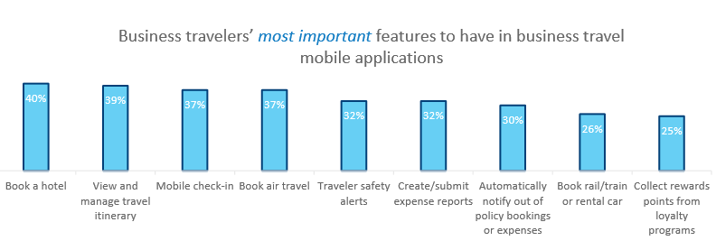
Business Traveler Report SAP Concur 2019
All Companies Big and Small
Business travelers want flexibility
Travel my way
Employees are not getting what they need from their employers
Employees needs should not go unnoticed
Support
Resources
Technology go hand in hand to provide a feeling of security while on the road
Notes:
Technology: • Canadians surveyed have the third-highest rate of agreement that their company is behind in adopting the latest technologies to manage travel (73%), compared to the global sentiment (67%).
• When it comes to technologies that need the most attention, 61% of Canadians say their company is lagging in booking and expense reporting tools and 57% of Canadians say their company is lagging in travel safety tools.
• 42% of business travellers said the ability to book a hotel was the most important mobile feature o 38% said the ability to book air travel was the most important mobile feature.
• 61% of Canadian business travellers would prefer to re-book online if their travel arrangements were cancelled while travelling for business. o 39% would rather re-book via phone. o 46% would book with their company’s travel agency or department, which might not offer online rebooking.
• Companies’ travel agencies and departments are currently the least popular (46%) tools for business travel, compared to employees who use online travel agencies (60%), book directly (53%) and use online booking tools (49%).
• 74% of Canadian business travellers who use online booking tools find these solutions offer better information and 71% said better prices.
• 84% of Canadian business travellers are willing to share information to improve their business travel experience, especially their hotel expenses (60%) and flight itineraries (54%).
This research clearly demonstrates employees aren’t getting what they need from their employers while travelling for business. These are important factors to consider as you’re planning events, there are challenges that persist for employees when it comes to how they’re booking their travel, safety concerns and more.
Organizations of all sizes shouldn’t let these concerns go unnoticed. Employees want more support, resources and technology that will improve their overall experience and increase feelings of security while on the road – ultimately providing a more enjoyable experience.

Slide 4
Business Traveler Report 2019
https://www.concur.com/en-us/resource-center/whitepapers/business-traveler-report-2019

Slide 5
The SAP Concur Survey was conducted by Wakefield Research among 7,850 business travellers, defined as those who travel for business 3+ times annually from the following 19 global markets: US, Canada, UK, Germany, France, Belgium, Netherlands, Luxembourg, Sweden, Denmark, Norway, Finland, Australia, Japan, China/Hong Kong/Taiwan, Singapore/Malaysia, India, Mexico and Brazil. Fielding occurred between July 29 and August 12, 2019, using an email invitation and an online survey.
In Canada, 500 respondents were included.
Victoria DeBoon
Director, Nationals SAP Concur Canada
Victoria.deboon@sap.com
Office 778.373.9172

